Slide 1
Clean Power Plan
Final Rule Model

Slide 2
A lot has changed!

Slide 3
The Proposed Clean Power Plan
EPA proposed state goals (lb CO2/MWh)
Interim goal (2020-2029)
Final goal (2030 and beyond)
State goals based on the “best system of emission reduction” (BSER) as determined by EPA
EPA’s BSER focuses on entire interconnected power system, not just existing EGUs
Four Building Blocks to quantify reductions in state CO₂ emissions
Objective = 30 percent reduction nationally from 2005 levels

Slide 4
SC Model of Proposed Rule (2.0% Growth)
17.6 m MWh

Slide 5
SC Model of Proposed Rule (1.0% Growth)
5.4 m MWh

Slide 6
The Final Clean Power Plan
Established uniform national emission rates for steam electric generating units & IGCC units and NGCCs
1305 lb CO₂/MWh for steam electric and IGCC
771 lb CO₂/MWh for NGCC
Rates applied to state generation mixes to create state goals
Interim goal 2022-2029 (phasing-in of unit rates)
Final goal 2030 and beyond (full implementation of unit rates)
Step goals within interim period ensure continued progress toward full implementation
Projected outcome = 32 percent reductions from 2005 levels by 2030

Slide 7
Final Rule – SC Rate
1791
635 #/MWh
35.4 %
1156

Slide 8
Final Rule – SC Mass
35.893
9.894
27.6 %
25.998

Slide 9
The Final CPP: Forget What You Know
Focus is clearly on UNITS not states
Approach to BSER is different
Quantify reductions that can be achieved by units (instead of states)
Shifts in generation due to interconnected nature of power system make up bulk of reductions (regional approach)
Ability to trade emission reduction credits (ERC) or allowances underpins entire approach
EPA assumes that a national trading system will emerge (see proposed federal plan)
States’ main job: select plan type, apply emission rates/limits to units and determine mechanism to allow trading
Affected Units must achieve SIP targets (emission reductions or trade ERCs/emission allowances)
Affected Units are subject to enforcement

Slide 10
The Clean Power Plan is not your typical rule
111(d)
EPA Sets different “Goals” for each State based on National Uniform Emission Rates
State writes a State Implementation Plan (SIP) to meet Goal
SIP sets out requirements for affected units, credits and trading mechanism, tracking
States which do not have a working SIP will receive a Federal Implementation Plan (FIP)

Slide 11
Utility-Produced CO2 in South Carolina - 2012
Notes:
This starts the discussion on Challenge #2. This pie chart shows the CO2 emitted by EGUs in the rule in 2012 (including those since shut down). This is EPA’s baseline in its goal calculations.

Slide 12
Plant Capacity Affected Units in 2022 (MW)
Notes:
This illustrates the remaining capacity in South Carolina by company (note this is in MW, not MWh or tons CO2). Duke no longer operates affected units in SC. Also, two of the power wholesalers, LS Power has significant capacity that was not used in 2012.

Slide 13
State Plan Types

Slide 14
Mass Options

Slide 15
Rate Options

Slide 16
Where do we go from here?
Analyze the baseline using forecast generation
Develop a Model to analyze various compliance strategies
Provide input to the SIP

Slide 17
What are Model Workgroup Objectives?
Prepare robust SC model to further Stakeholder understanding of this complex rule.
The efforts must represent stakeholders throughout SC with diverse power generation resources and compliance challenges.
The model must allow users to analyze state progress towards compliance with the Clean Power Plan rule under a range of electricity demand and generation scenarios and a variety of emissions reduction targets.

Slide 18
What are Our Objectives?
SC Stakeholders must be able to use the model to explore compliance options. Specific Clean Power Plan evaluations should include:
Rate- versus mass-based compliance options
Impact of new capacity additions, retirements, and energy efficiency savings on compliance scenarios
Potential market implications of different regulatory approaches
Addressing leakage under a mass-based approach
Multi-state compliance options
Early action crediting under the Clean Energy Incentive Program
Allowance allocation and ERC program design options
Emissions reduction requirements needed after accounting for state policies (RPS, EERS, etc.)

Slide 19
What did EPA Use? (From Website)
EPA uses the Integrated Planning Model (IPM) to analyze the projected impact of environmental policies on the electric power sector.
Developed by ICF Consulting, Inc., IPM is a multi-regional, dynamic, deterministic linear programming model of the U.S. electric power sector.
It provides forecasts of least-cost capacity expansion, electricity dispatch, and emission control strategies for meeting energy demand and environmental, transmission, dispatch, and reliability constraints.
IPM can be used to evaluate the cost and emissions impacts of proposed policies to limit emissions of carbon dioxide (CO₂) from the electric power sector.
IPM strengths:
its detail-rich representation of emission control options encompassing a broad array of retrofit technologies along with emission reductions through fuel switching, changes in capacity mix and electricity dispatch strategies; and
its ability to capture complex interactions among the electric power, fuel, and environmental markets.
IPM does not factor in ERCs, allowances, set-asides and trading!

Slide 20
South Carolina CPP Strategy*
Select Plan type with greatest margin of success for South Carolina now and in the future,
Maximum benefit to all SC customers throughout the State,
Recognition of values to all stakeholders,
Maximize trading of allowances or credits (intra and interstate),
Leverage incentives for RE/EE,
Simplicity in model for tracking and reporting.
* In approximate order of importance

Slide 21
Economic Model – SC Economy and Demand Growth
Predict Electric Demand
Forecast Utility Dispatch
Calculate CO2 Emissions
Evaluate 6 Plan Types
EE Avoidance
Redispatch
“Best” Path to Compliance

Slide 22
Data Collection
Step 1. discuss the mechanics of information sharing between the generation companies. Questions about how much information can be shared, how that sharing takes place, and whether 3rd party software would make that sharing easier.
Hold On – There are Rules about sharing data!

Slide 23
Data Impediments
Wholesale versus Retail Providers
Avoid sharing proprietary & competitive information
Confidential Business Information
Avoid anti-trust issues
How to predict future interstate import/export
Avoid FERC Issues

Slide 24
FERC Compliance
Standards of Conduct
The Standards of Conduct ("SOC" or "Standards") governs the relationship between Transmission Providers (electric and natural gas) and their customers (affiliated and non-affiliated). The Standards ensure that Transmission Providers do not extend their market power over transmission to wholesale energy markets by giving their affiliates unduly preferential treatment.
The four (4) elements of the Standards are:
Non-Discrimination Requirement: requires Transmission Providers to treat all transmission customers, affiliated and non-affiliated, in a non-discriminatory manner and to provide equal access to Non-Public Transmission Function Information, ("NPTI").
Independent Functioning Rule: requires all Transmission Function Employees and Marketing Function Employees to operate independently of each other.
No-Conduit Rule: prohibits the passing of NPTI to Marketing Function Employees.
Transparency Rule: imposes posting requirements for the Transmission Provider.

Slide 25
FERC Compliance
Critical Energy Infrastructure Information (CEII)
Prohibits sharing specific engineering, vulnerability, or detailed design information about a proposed or existing critical infrastructure that:
Relates details about the production, generation, transportation, transmission, or distribution of energy;
Could be useful to a person in planning an attack on critical infrastructure;
Is exempt from mandatory disclosure under the Freedom of Information Act, 5 U.S.C. 552 (2000); and
Does not simply give the general location of the critical infrastructure, 18 C.F.R. § 388.113(c)(1)(i).

Slide 26
Components of CEII Definition
FERC
“(i) Relates details about the production, generation, transportation,
transmission, or distribution of energy”
CEII protects detailed information
Narratives such as the descriptions of facilities and processes are generally not CEII
Information must concern the production, generation, transportation, transmission, or distribution of energy
Examples
Power flow data
Transmission planning data
System performance data

Slide 27
Path Forward
Review proposed data worksheet,
Agree on format and level of detail,
Complete the data input by all appropriate parties,
Integrate and share data worksheet,
Workgroup meeting after mid-October to discuss evaluation of baseline case and model development.

Slide 28
Existing Sources

Slide 29
New Sources

Slide 30
EE and DSM

Slide 31
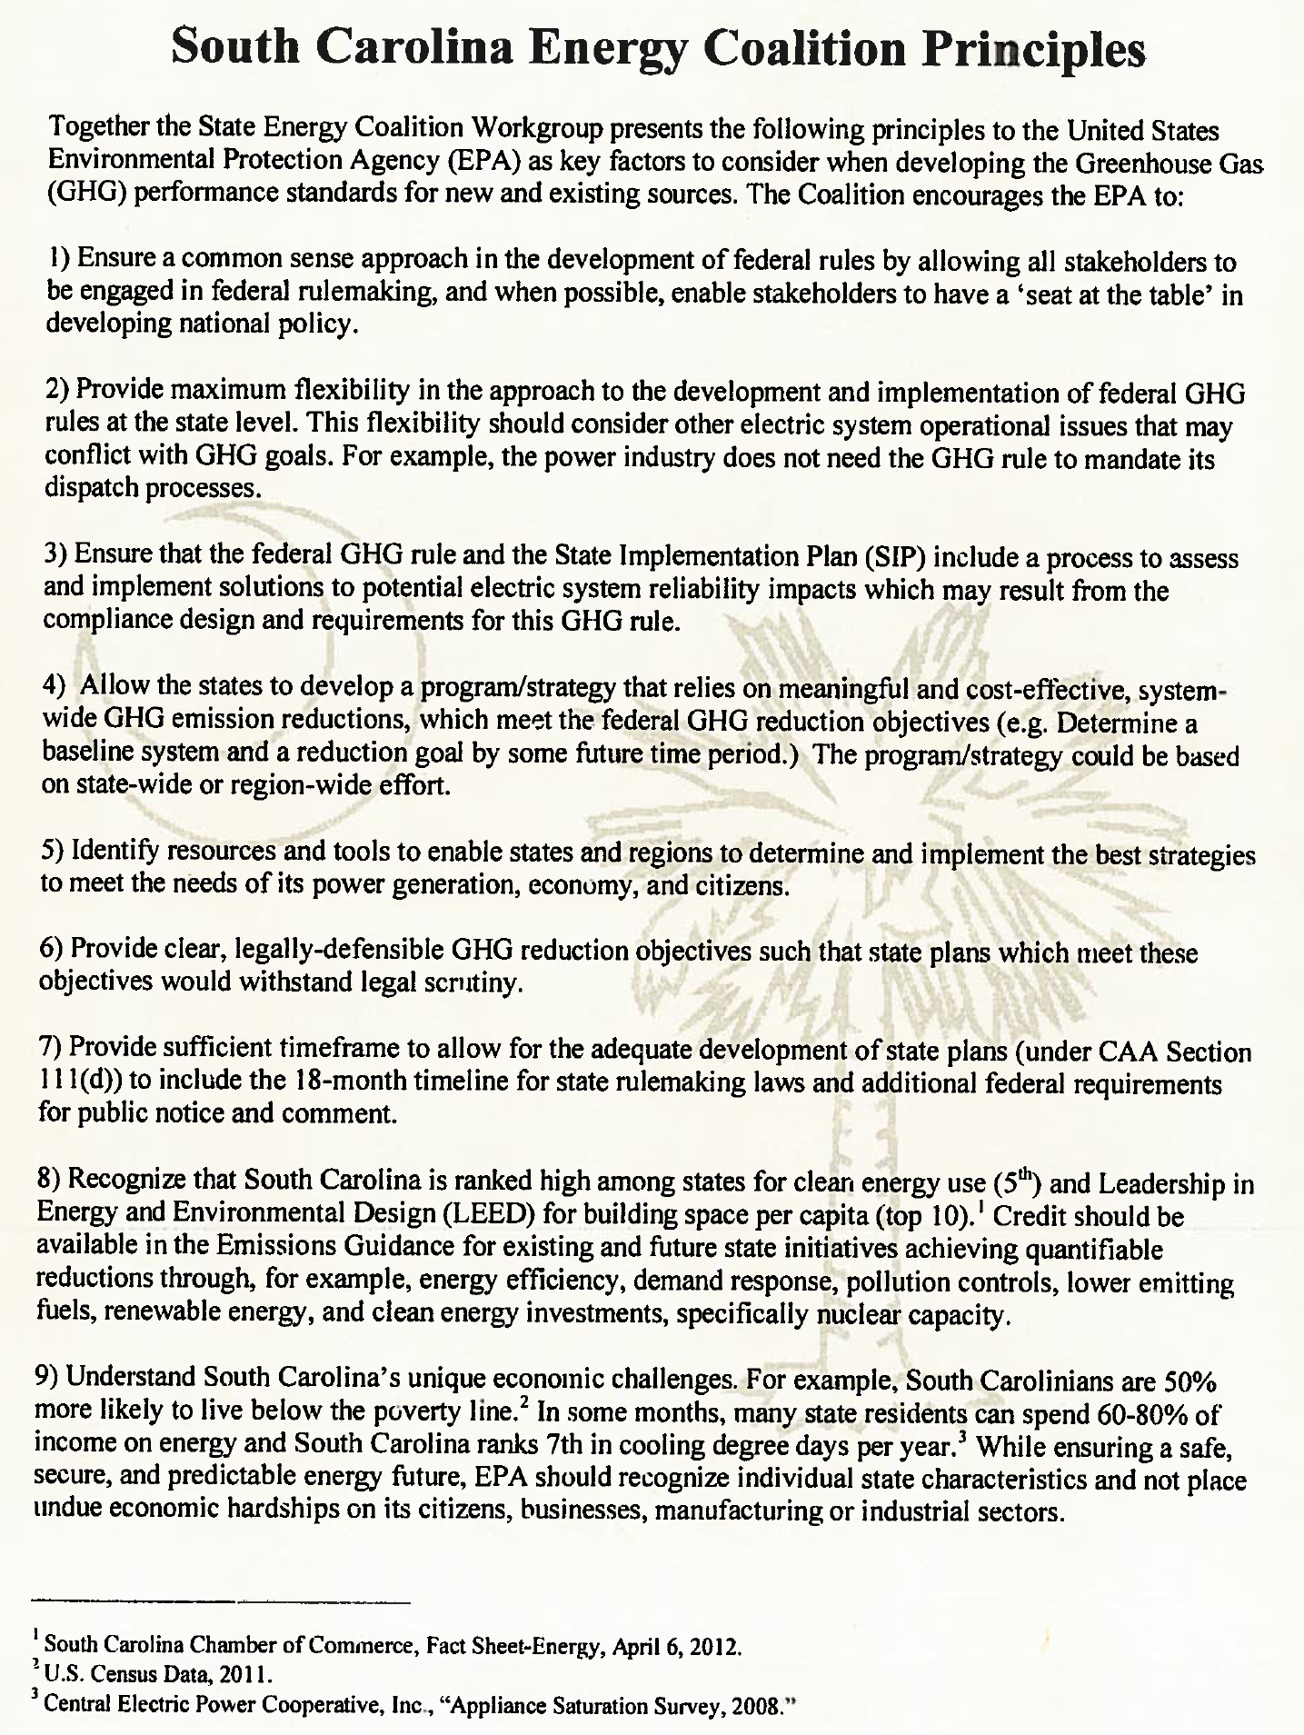

Slide 32
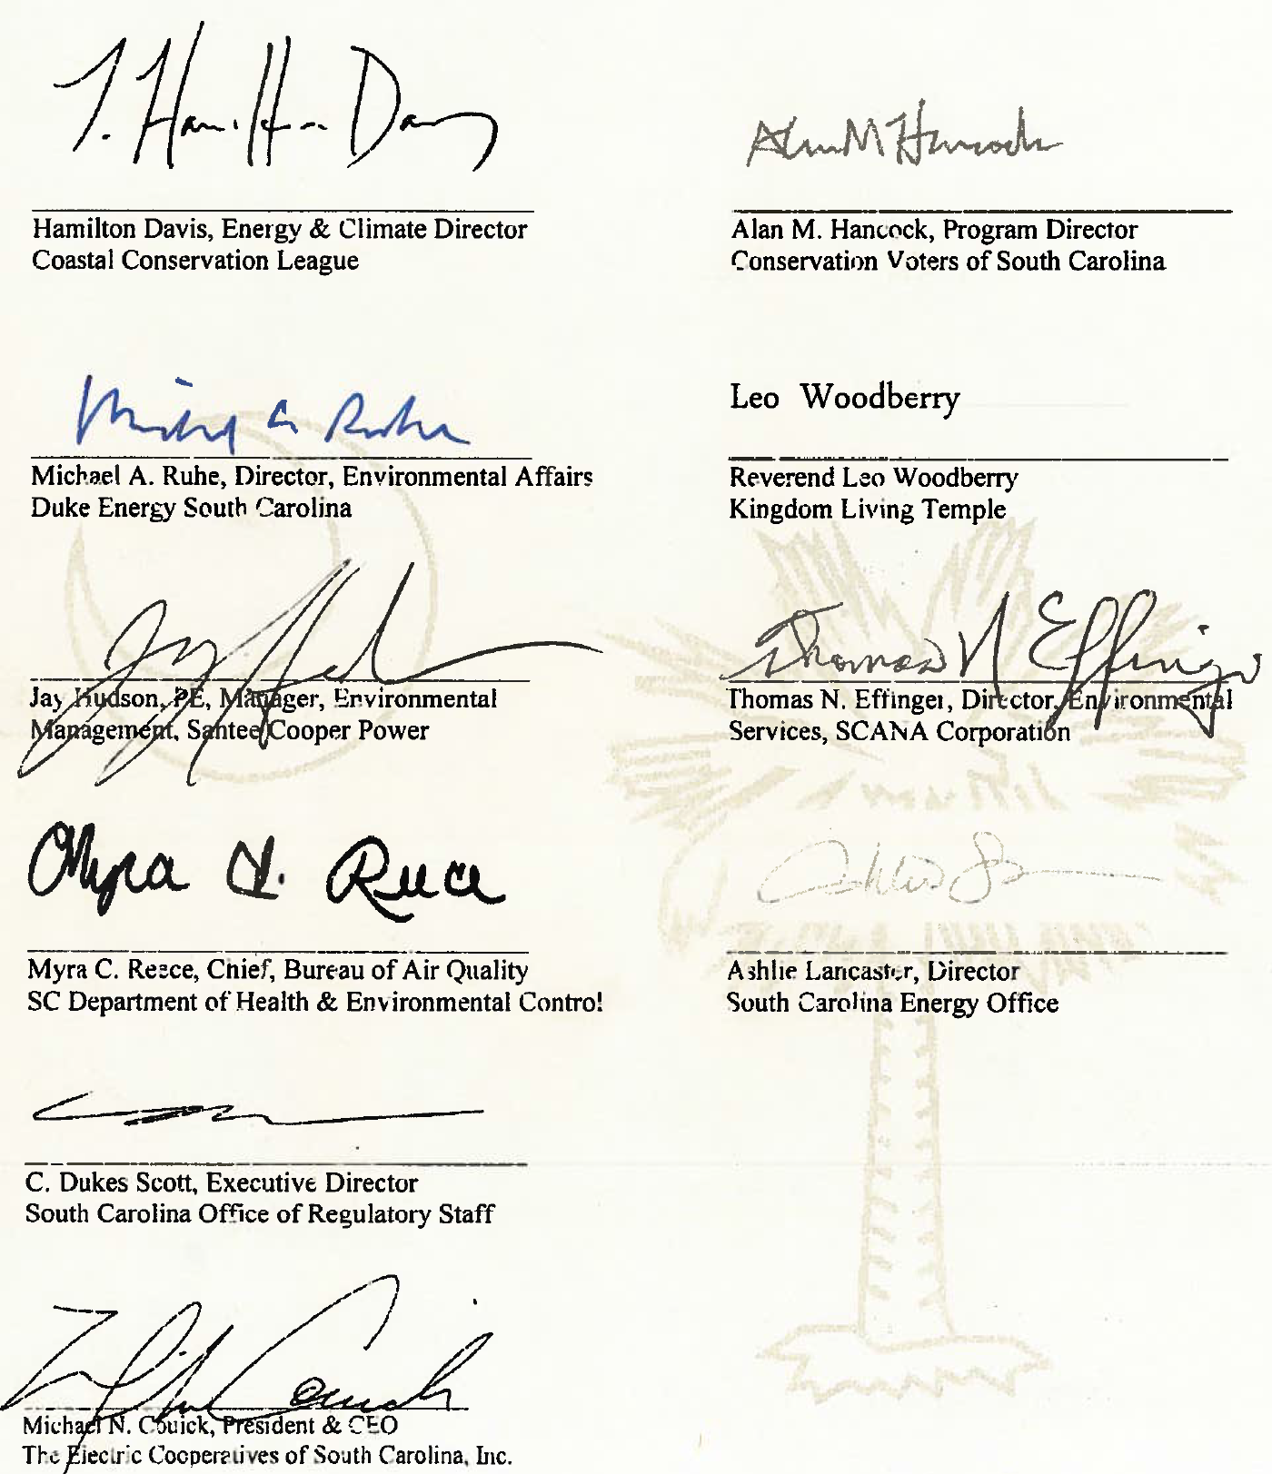

Slide 33
Questions and Comments?

