Slide 1
FFY2024 HHPD Webinar
Will begin at 2:05 PM
Facilitators: Sam Johnson and Brittany Felder
Any tech problems, post in Chat or e-mail Response@dhec.sc.gov and we will respond
Microphones not active by default – facilitator can unmute if needed
Use Chat for questions, tech problems, etc.
Q&A at end of presentation

Slide 2
FFY2024 High Hazard Potential Dams Rehab Grant
Apr 10, 2024

Slide 3
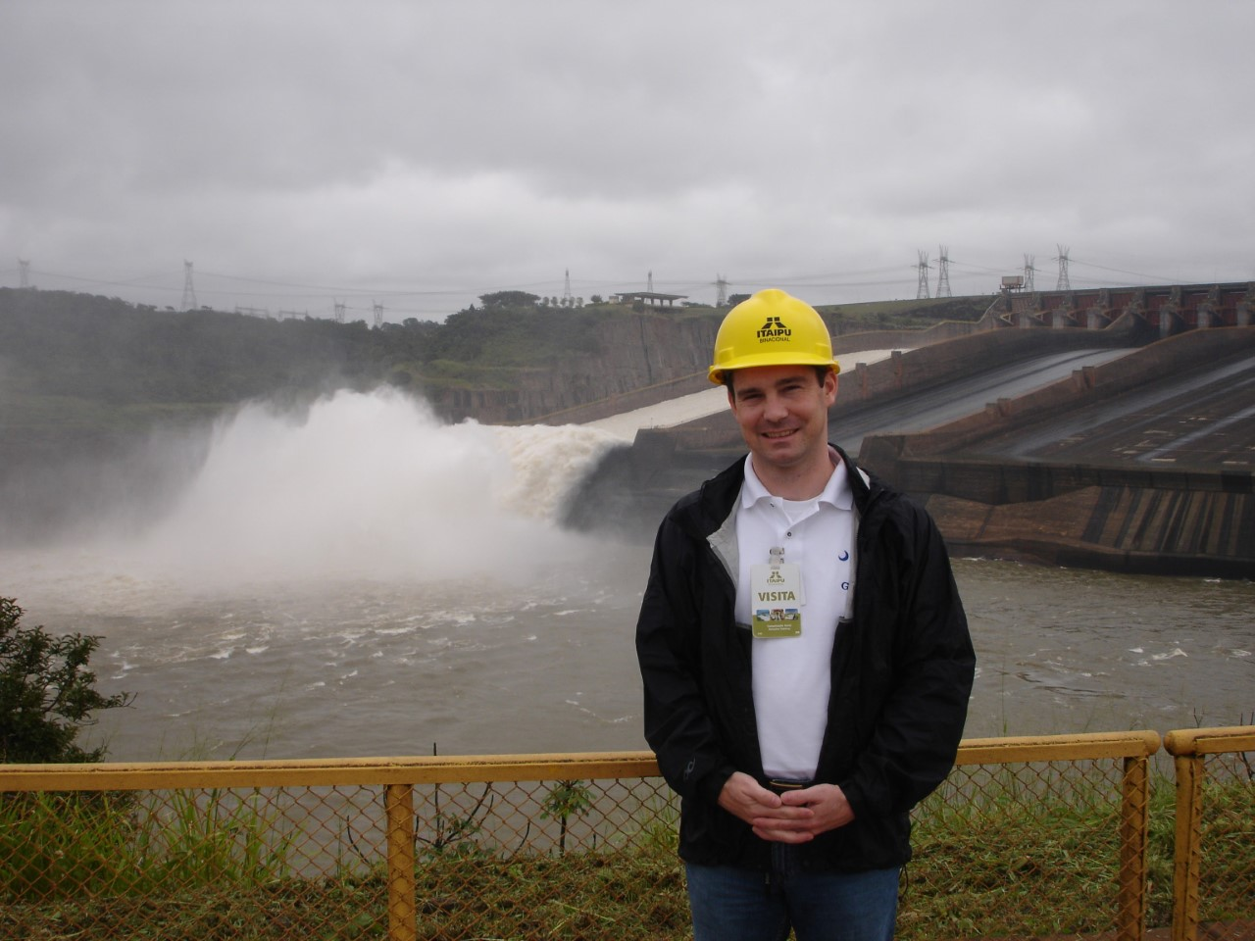
Your Presenter
John M. McCain, P.E.
Section Manager
SC Dam Safety Program
(803) 898-8178
mccainjm@dhec.sc.gov

Slide 4
Agenda
Background and available funds
Dam eligibility
Applicant eligibility
Eligible/allowable activities
State and Federal requirements of a grant award
  Special requirements for construction projects
Grant application process
DHEC’s application review and award selection process
Estimated Timeline
Questions and Answers

Slide 5
Background
National High Hazard Potential Dams (HHPD) Rehabilitation Grant Program created December 16, 2016 with passage of the Water Infrastructure Improvements for the Nation (WIIN) Act
History of Appropriations (FFY = Federal Fiscal Year):
  FFY19 $10,000,000
  FFY20 $10,000,000
  FFY21 $11,640,000
  FFY22 $22,000,000
  FFY23 $0
  FFY24 $185,120,000
  FFY25 $185,120,000
  FFY26 $185,120,000
Annual Appropriations
(i.e., Federal budget)
Infrastructure Investment and
Jobs Act (IIJA) aka Bipartisan Infrastructure Law (BIL)
Specifies $75M for dam removals
This grant
Notes:
Remember to call out dam removal funding!

Slide 6
Available Funds for FFY24
Should know any day soon!
Total Federal appropriation: $185,120,000
  1/3 divided evenly among all state applicants
  2/3 divided among states based on application’s share of eligible dams
Our percentage of the $22M in FFY22 = 5.24%
Same percentage for FFY24 = $9,700,288

Slide 7
Match Requirement
No HHPD grant can exceed 65% of total project cost
Applicant must secure minimum 35% from non-Federal sources
35% Match can come from:
  Cash (not other Fed grants)
  Donated Services, Materials, Labor, Equipment
  Your own work force (“Force Account”)
“In-Kind Contributions”

Slide 8
Dam Eligibility
Regardless of ownership, a dam is eligible for grant funding if:
  The dam meets the Federal definition of “dam” found in the US Code of Laws, Title 33, Chapter 9, Section 467(3);

Slide 9
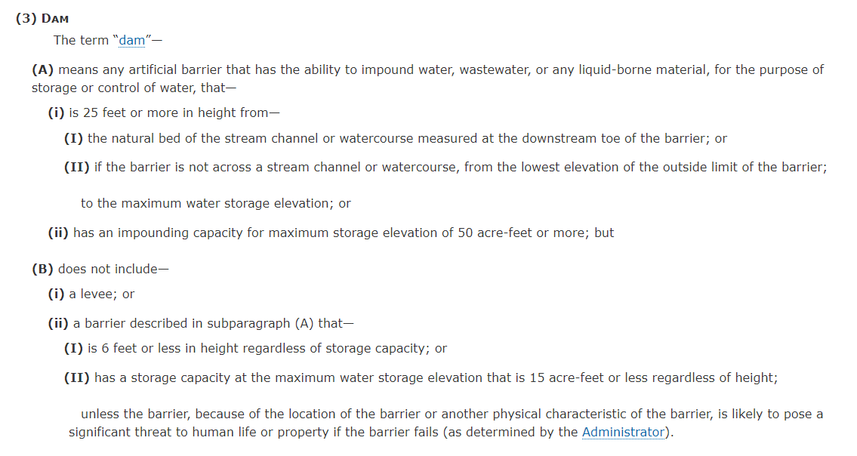


Source: https://www.law.cornell.edu/uscode/text/33/467

Slide 10
Dam Eligibility, Cont’d
  2. It is a non-Federal dam;
  3. The dam is located in a state with a State dam safety program;
  4. The dam is classified as “high hazard potential” by the State dam safety agency;
  5. The dam has an Emergency Action Plan (EAP) approved by the State dam safety agency;
  6. The dam fails to meet minimum state dam safety standards and poses an unacceptable risk to the public;

Slide 11
Dam Eligibility, Cont’d
7. The dam is NOT a licensed hydroelectric dam;
8. The dam was NOT built under the authority of the Secretary of Agriculture;
9. The dam’s primary deficiency(ies) are NOT solely the result of insufficient maintenance; and,
Notes:
Explain bullet number 9 in more detail. What are examples of insufficient maintenance that would make dam ineligible.

Slide 12
Dam Eligibility, Cont’d
10. The dam was rated either “Poor” or “Unsatisfactory” at last DHEC inspection OR was rated “Fair” and has a Population at Risk (PAR) of >= 1,000
Notes:
What is Population-at-Risk and who/how is it determined?

Slide 13
FY24 HHPD Eligible Dams
43 dams determined to be eligible
List available at: https://scdhec.gov/BOW/dams-reservoirs/high-hazard-potential-dams-rehabilitation-grant
We are happy to discuss why your dam was/was not eligible upon request
Notes:
Make sure to mention that we can help dam owners understand what they can do to become eligible!

Slide 14
Applicant Eligibility
If a dam is eligible for the grant, who can submit a grant application?
  A non-Federal government (e.g., State Agency, County/Municipal/Tribal government, Special Purpose District)
  A non-profit organization
    From FEMA: “Eligible nonprofit organizations are those organizations that are described under section 501(c)(3) or 501(c)(4) of the Internal Revenue Code of 1986 (IRC) and exempt from tax under section 501(a) of such code.”
Notes:
Mention how HOAs fall into this

Slide 15
Applicant Eligibility, Cont’d
So what is a private dam owner to do?
  An individual/private citizen cannot apply directly
  Must find a Project Sponsor (has to be eligible applicant that is willing to apply on dam owner’s behalf)
  The Project Sponsor is the applicant and assumes responsibility for the project, to include compliance with grant requirements and Federal laws and regulations, receiving and spending grant funds, and more
Notes:
Mention multiple sponsors are potentially available for dam removals

Slide 16

Sponsor-Dam Owner Relationship
Contractors & Engineers
Dam Owner
Sponsor
DHEC
FEMA
Invoices
Paid Invoices, Cleared Checks, Documentation of In-Kind Goods/Services, Status Reports, Deliverables
Requests for Reimbursement, Quarterly Progress Reports, Deliverables
Draw Requests, Quarterly Progress Reports

Slide 17
Eligible/Allowable Activities
“Rehabilitation” includes repair, replacement, reconstruction, or removal of a dam.
Pre-award expenses are not reimbursable!
What activities can be funded under this grant?
  Planning
  Preliminary Engineering
  Final Design
  Construction/Demolition
  Non-structural risk mitigation activities*
*activities that reduce risk/hazard class but do not require modifications to dam itself (e.g., elevate a home, enlarge a culvert or bridge, flood-proof infrastructure)

Slide 18
Eligible/Allowable Activities, Cont’d
Period of Performance = 36 months
  Start Date = FEMA Award to DHEC (e.g., 4/??/2024)
  End Date = 36 months later (e.g., 4/??/2027)
  All activities must be completed by the End Date; however, extensions are possible, but are subject to FEMA review and approval.

Slide 19
Eligible/Allowable Activities, Cont’d
Examples of Activities that are NOT Allowable by Law:
  Rehabilitate a Federal dam
  Rehabilitate a fully breached dam
  Perform routine maintenance and operation of a dam
  Modify a dam to produce hydroelectric power
  Increase water supply storage capacity
  Make any other modification that does not also improve the safety of the dam

Slide 20
State and Federal Requirements
As with any Federal grant, there is a long list of laws, regulations, Executive Orders, and programmatic requirements that must be met before, during, and after a grant-funded project
The Project Sponsor is responsible to DHEC and FEMA for compliance with all State and Federal Requirements, even if Project Sponsor is not the dam owner!
  To protect itself from liability, Sponsor should have separate agreement with dam owner
  All records should be retained at least 3 years

Slide 21
State and Federal Requirements, Cont’d
Federal requirements:
  Environmental and Historic Preservation (EHP)
  Non-Discrimination in the Workplace
  Procurement
  Cost Principles, Audit Requirements, Administrative Requirements
  Debarment and Suspension Rules
  Drug-Free Workplace

Slide 22
State and Federal Requirements, Cont’d
Federal requirements, cont’d:
  Fair Wages and Labor Standards (aka Davis-Bacon Act, applies to construction)
  Federal Funding Accountability and Transparency Act (FFATA)
  Single Audit Act
  Uniform Relocation Assistance and Real Property Acquisition Act (for purchasing property)
  Buy American, Build American Act (BABAA)

Slide 23
State and Federal Requirements, Cont’d
Programmatic Requirements (from FEMA):
  Maintenance and Operations agreement for the life of the rehabilitated dam (only applies to construction)
  Local Hazard Mitigation Plan that addresses “all dam risk” (if not in place at time of application, must request 12-month extension)
  Floodplain Management Plan that addresses flooding risks in the downstream area protected by the dam (must be developed within 2 years of award, and implemented within 2 years of completion of construction project)

Slide 24
Local Hazard Mitigation Plan (LHMP)
To comply, must either:
  A) Mitigation planning jurisdiction where the dam is located has a FEMA-approved LHMP at time of application*, OR
  B) Request a 12-month extension to develop a compliant plan and receive FEMA approval
Failure to comply w/i 12-month period requires repayment of funds
No extensions will be granted by FEMA
*Anderson, Oconee, and Spartanburg have plans in place that satisfy this requirement
Notes:
This is a big stumbling block

Slide 25
Floodplain Management Plan
FPMP shall address:
  Potential measures, practices, and policies to reduce...adverse impacts of flooding in the area "protected" by the project
  Plans for flood fighting and evacuation
  Public education/risk communication targeting communities in the inundation area
Notes:
This is a big stumbling block

Slide 26
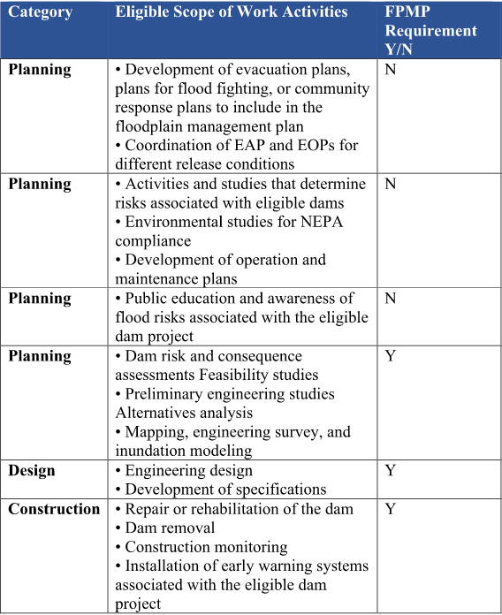

Slide 27
Federal Procurement
Procurement requirements apply for acquisition of contractors, engineers, surveyors, material, equipment, etc.
Informal Procurement vs. Formal Procurement
Cost-based procurement vs. Qualifications-based
  Grants ≥$1,000,000 must utilize qualifications-based methods for architects, engineers, construction management, etc.
RFPs, RFQs, IFBs, etc., must mention federal funds are being used and federal requirements apply, especially those that could affect bid/quotation price (Davis-Bacon Act, Buy American-Build American Act)

Slide 28
State Requirements
Reimbursement only (no funds in advance of work being performed and paid for)
State Procurement Code (if a county or local government entity is dam owner or sponsor)
  Non-Profits may not have to follow State Procurement, but have to follow organization's procurement policy and Federal requirements in 2 CFR 200

Slide 29
Special Requirements for Construction Projects
New this year: Does not have to be a construction-ready project!
  Design must be complete, but not required to have all permits/approvals in place and ready for bids
Requires Floodplain Management Plan creation (w/i 2 years of award) and implementation (w/i 2 years of completion of construction)
Requires Operations and Maintenance Plan
Requires O&M commitment for life of improvement

Slide 30
Enviro. & Historic Preservation
Types of Projects that require EHP review (not exhaustive list):
  Any ground disturbance
  Impacts to 100-yr flood elevations
  Loss of farmland
  Impacts to Threatened or Endangered Species
  Impacts to properties on National Register of Historic Places
Application must provide everything needed for FEMA's EHP review:
  Detailed description of disturbance with area, depth, latitude/longitude, duration
  Photos of existing area

Slide 31
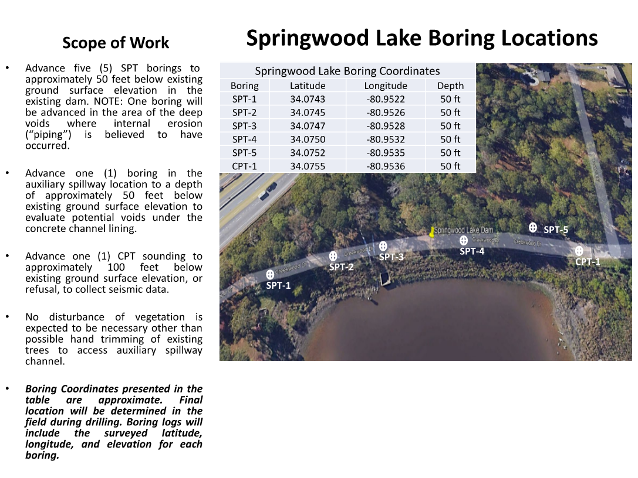
Env & Hist Preservation, cont'd
Example from previous year's grant application – FEMA will want to see details!

Slide 32
Env & Hist Preservation, cont'd
Public notice period required for any impacts
  Newspaper, website, physical signage all OK
  Must provide period for public comments (min. 30 days)

Slide 33
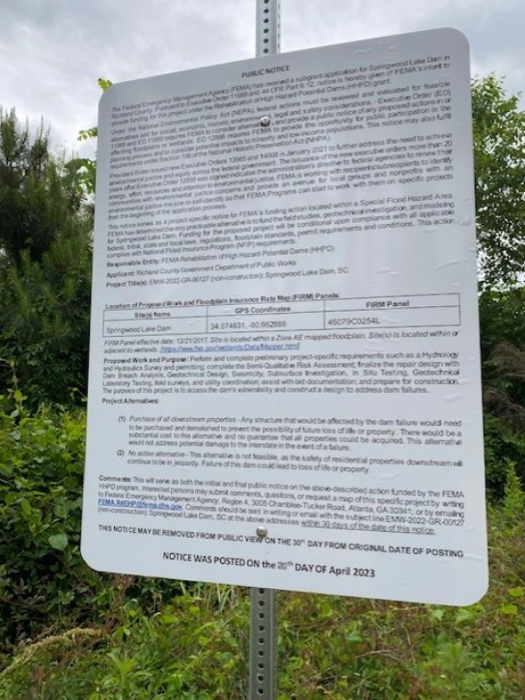
Sign posted near Springwood Lake Dam for potential impacts to 100-yr flood and for geotechnical borings

Slide 34
Application Process
What constitutes an Application for this grant opportunity?
  Completed Application Form # D-4132
  Eligibility Narrative
  Project Narrative
  Plan to advance project to final design and construction
  Project Milestones (for the proposed scope of work)

Slide 35
Application Process, Cont’d
Detailed Budget (for the proposed scope of work)
Procurement Policy(ies) that will be followed
Description of Match (i.e., where will non-Federal funds come from)
Match Commitment Letter
FEMA-approved Local Haz Mitigation Plan or Copy of Extension Request to FEMA – will need to coordinate with County

Slide 36
Application Process, Cont’d
Completed Environmental and Historic Preservation Checklist
Signed Statements of Assurance/Certifications
Certification that a Floodplain Management Plan will be developed within 2 years of award

Slide 37
Application Process, Cont’d
Application must be created with the assistance of a licensed Professional Engineer registered in South Carolina
Checklist for grant application will be available on Dam Safety website

Slide 38
Application Review and Selection
New this year – Project Prioritization Tool
  FEMA developed for risk-based prioritization as required by WIIN Act
  Primary Screening Methodology (only necessary where there is insufficient funding for all proposed sub-awards)
  Secondary Screening Methodologies acceptable (DHEC still considering)
Brings up question: Can dam removals still be given funding priority as in previous years?
  Hopefully, dam removals will always represent greatest risk reduction compared to leaving a dam in place!
NO PROJECTS ARE GUARANTEED TO RECEIVE FUNDING
Notes:
We’ll try our best to fund as many projects as possible, but no applicant should expect guaranteed funding

Slide 39
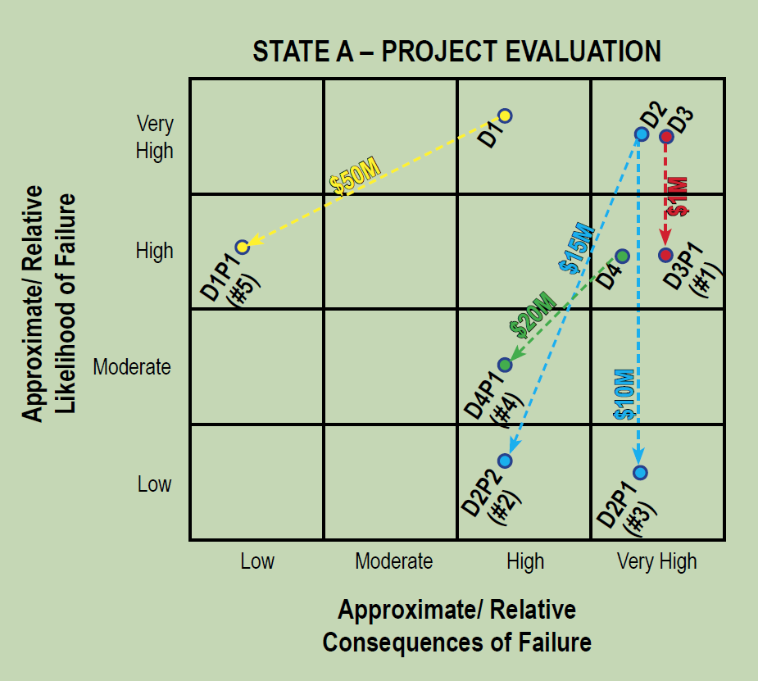
Project Prioritization by Risk
Risk = Likelihood of Failure x Consequences of Failure

Slide 40
D5
$1M
D5P1

Slide 41
Project Prioritization, cont’d
Will only be implemented if DHEC receives more requests for funding than available funds can satisfy
DHEC must follow FEMA’s rules for project prioritization
  Likelihood of Failure (x-axis) comes from FEMA’s Project Prioritization Tool
  Consequences of Failure (y-axis) comes from USACE Dam Screening Tool

Slide 42

Estimated Timeline
February 27, 2024 – DHEC grant application submitted to FEMA
April ??, 2024 - FEMA grant award to DHEC
Mid-April 2024 - DHEC issues its Notice of Funding Opportunity and begins accepting grant applications from dam owners
June 14 - application deadline
June 21 - initial application screening completed (by DHEC) / list of finalists created / meeting of review panel
June 28 - review panelists rank applications on "Finalists list“ – sub-award decisions made
July 1 - DHEC submits amended grant application with proposed sub-awards to FEMA for approval
Oct 2024 - FEMA approves proposed sub-awards
Dec 2024 – DHEC executes sub-awards

Slide 43
Beyond FFY24
Dams not eligible for FFY24:
  Funding is secured for FFY25 & FFY26 ($185,000,000/year)
  How can dam become eligible for next year?
    Need approved EAP
    Identify deficiencies that aren’t solely due to a lack of maintenance
    Work with DHEC inspector regarding inspection rating – inspector may not know of all deficiencies that need correcting
Grant requirements CAN CHANGE each year!

Slide 44
Beyond FFY24, cont’d
Recommendations for prospective applicants for FFY25 and beyond:
  Start planning now! Talk to us if you have a project in mind!
  No construction without a complete design
  Follow procurement for engineers/consultants to assist with project planning/grant application
  Contact county regarding their LHMP
  Start search for a Project Sponsor, if needed
  Coordinate with other owners/stakeholders
  Find partners for cost match or in-kind contributions

Slide 45
For any questions, contact the Dam Safety Program at:
response@dhec.sc.gov
Detailed information and grant application instructions can be found at:
www.scdhec.gov/dams

